Slide 1


Congestion Control
in Data Centers
H. Jonathan Chao
ECE Department
New York University

Slide 2
Outline
Overview of Congestion Control (CC) in Data Centers
RDMA (Remote Direct Memory Access)
PFC (Priority Flow Control)
HPCC (High Precision Congestion Control)

Slide 3
Introduction
The link speed in data center networks has grown from 1Gbps to 100Gbps in the past decade, and this growth is continuing.
Ultralow latency and high bandwidth are two critical requirements in today’s and future high-speed networks.
Congestion control (CC) is the key to achieving ultra-low latency, high bandwidth and network stability in high-speed networks*.
* HPCC, Sigcomm 2019

Slide 4
Two critical trends in datacenters driving high-speed networks
The first trend is new data center architectures like resource disaggregation (RD) and heterogeneous computing (HC).
In RD, CPUs need high-speed networking with remote resources like GPU, memory and disk, which requires 3 - 5μs network latency and 40-100Gbps bandwidth to maintain good application-level performance.
In HC, different computing chips, e.g. CPU, FPGA, and GPU, also need high-speed interconnections, and the lower the latency, the better.
The second trend is new applications like storage on high I/O speed media, e.g. NVMe (non-volatile memory express) and large-scale machine learning training on high computation speed devices, e.g. GPU and ASIC.
These applications periodically transfer large volume data, and their performance bottleneck is usually in the network since their storage and computation speeds are very fast.

Slide 5
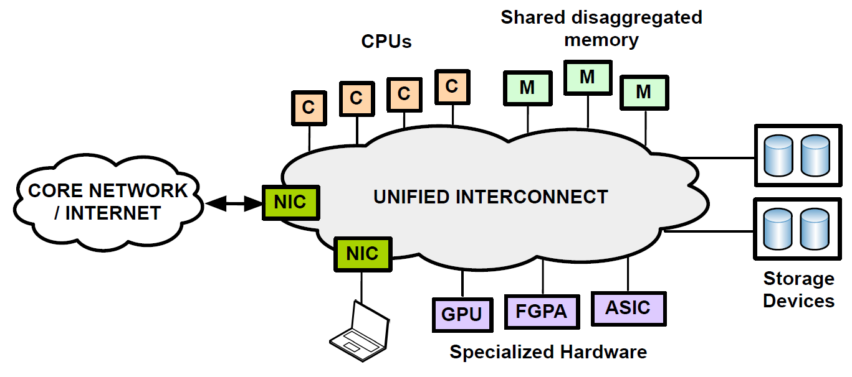
Disaggregated Datacenters
[Hotnets2013_ddc_slides]

Slide 6
RDMA Challenges
Traditional software-based network stacks in hosts can no longer sustain the critical latency and bandwidth requirements.
Offloading network stacks into hardware is an inevitable direction, such as RDMA (remote direct memory access) over Converged Ethernet Version 2 (RoCEv2).
RDMA networks face fundamental challenges to reconcile low latency, high bandwidth utilization, and high stability with two reasons below.
High speed implies that flows start at line rate and aggressively grab available network capacity, causing severe congestion in large-scale networks.
High throughput usually results in deep packet queueing, which undermines the performance of latency-sensitive flows and the ability of the network to handle unexpected congestion.

Slide 7
Two Problematic Cases in RoCEv2 Networks
PFC (priority flow control) storms: A cloud storage cluster with RDMA once encountered a network-wide, large amplitude traffic drop due to a long-lasting PFC storm, which was often triggered by a large incast event.
Solution: tuned the CC algorithm to reduce rates quickly and increase rates conservatively to avoid triggering PFC pauses, resulting in a lower average link utilization in the network (higher cost).
Long latency: A machine learning (ML) application complained about > 100us average latency for short messages; its expectation was a tail latency of < 50μs with RDMA, caused by a cloud storage system that is bandwidth intensive.
Solution: separate the two applications by deploying the ML application to a new cluster with low utilization (higher cost) given that the ML application is not very bandwidth hungry. Difficult and costly to manage two separate networks.

Slide 8
What is RDMA?
Direct memory access (DMA) is an ability of a device to access host memory directly, without the intervention of the CPU(s).
RDMA (Remote DMA) is the ability of accessing (i.e., reading from or writing to) memory on a remote machine without interrupting the processing of the CPU(s) on that system.

Slide 9
What is RDMA?
Remote
data transfers between nodes in a network
Direct
no operating system Kernel involvement in transfers
everything about a transfer offloaded onto Interface Card
Memory
transfers between user space application virtual memory
no extra copying or buffering
Access
send, receive, read, write, atomic operations
Cite: Introduction to RDMA programming, Author: Robert D. Russell, InterOperability Laboratory & Computer Science Department, University of New Hampshire

Slide 10
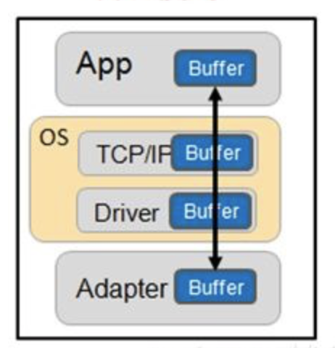
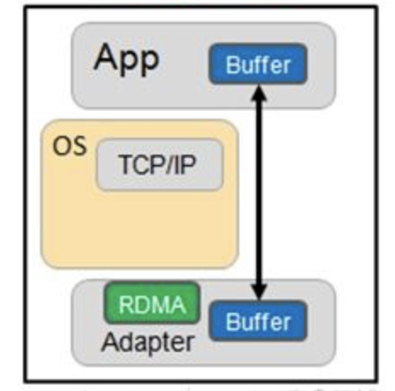
RDMA Introduction
Tradition Mode
RDMA Mode
RDMA benefit: 1.Low-Latencey 2.Low CPU overhead 3.High bandwidth

Slide 11
Why RDMA?
Zero-copy - applications can perform data transfer without the network software stack involvement and data is being sent directly to the buffers without being copied between the network layers.
Kernel bypass - applications can perform data transfer directly from user space without the need to perform context switches.
No CPU involvement - applications can access remote memory without consuming any CPU in the remote machine. The remote memory machine will be read without any intervention of remote process (or processor). The caches in the remote CPU(s) won't be filled with the accessed memory content.

Slide 12
Which network protocols support RDMA?
InfiniBand (IB) - a new generation network protocol which supports RDMA natively from the beginning. Since this is a new network technology, it requires NICs and switches which supports this technology.
RDMA Over Converged Ethernet (RoCE) - a network protocol which allows performing RDMA over Ethernet network. Its lower network headers are Ethernet headers and its upper network headers (including the data) are InfiniBand headers. This allows using RDMA over standard Ethernet infrastructure (switches). Only the NICs should be special and support RoCE.
Internet Wide Area RDMA Protocol (iWARP) - a network protocol which allows performing RDMA over TCP. There are features that exist in IB and RoCE and aren't supported in iWARP. This allows using RDMA over standard Ethernet infrastructure (switches). The NICs should be special and support iWARP (if CPU offloads are used). Otherwise, all iWARP stacks can be implemented in SW and loosing most of the RDMA performance advantages.

Slide 13
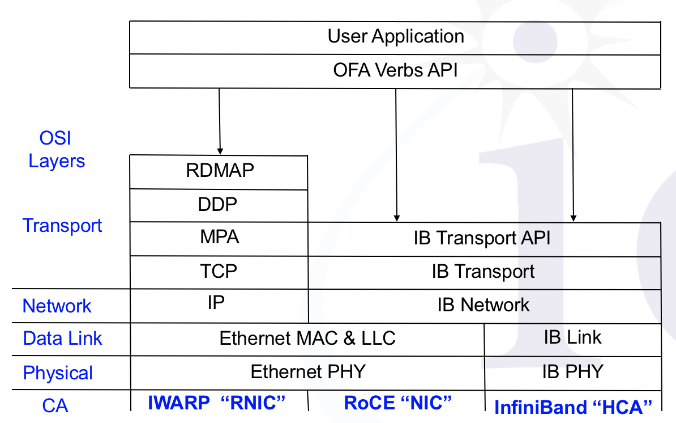
RDMA Architecture Layering
HCA: host channel adapter

Slide 14
Line Rates of Different RDMA Protocols
InfiniBand – (41.8% of top 500 supercomputers)
SDR 4x – 8 Gbps
DDR 4x – 16 Gbps
QDR 4x – 32 Gbps
FDR 4x – 54 Gbps (Fourteen Data Rate, 14 Gb/s per lane)
RoCE – RDMA over Converged Ethernet
10 Gbps
40 Gbps
iWarp – internet Wide Area RDMA Protocol
10 Gbps

Slide 15
RDMA Challenges
Challenge of using RDMA in a datacenter:
Performance is impaired with a lossy network due to the overhead from packet-retransmission
Solution:
Lossless networks are increasingly used in modern datacenters to avoid retransmissions delays
PFC (Priority Flow Control) is used to achieve a lossless network
PFC prevents buffer overflow at Ethernet switches and NICs. The switches and NICs monitor ingress queues at the incoming ports. When the queue exceeds a certain threshold, a PAUSE message is sent to the upstream.

Slide 16
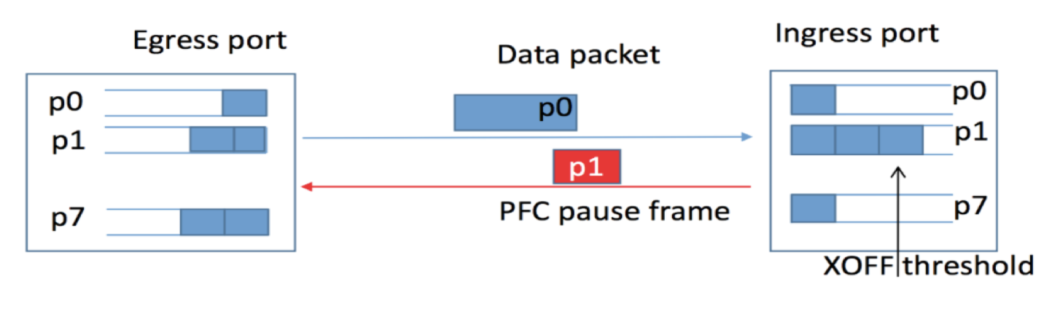
PFC (Priority Flow Control)
Ethernet Flow Control, separate control among 8 priority queues
Sender
Receiver
Cite: Priority Flow Control – Cisco

Slide 17
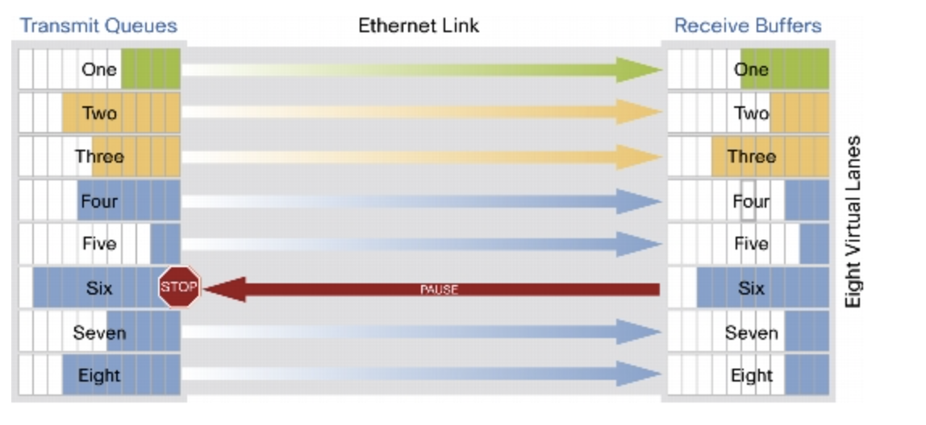
PFC (Priority Flow Control)

Slide 18
Lossless Network
Lossless network is a crucial infrastructure in many application scenarios.
HPC
Distributed
Storage
Data Center
Applications
Lossless Network
18
“Gentle Flow Control” in Sigcomm 2019
Notes:
Lossless network is a crucial infrastructure in many application scenarios
In HPC system, InterProcess Communication requires extremely low communication latency. Packet retransmissions caused by loss would lead to missing communication deadlines.
In block-based storage, lossless delivery of network packets is a critical requirement for providing satisfied quality of service.
In cloud data center, operators pursue losslessness to decrease flow completion time and improve overall application performance.

Slide 19
Lossless Flow Control
Hop-by-hop flow control
19
“Gentle Flow Control” in Sigcomm 2019
Notes:
Existing lossless networks employ hop-by-hop flow control mechanisms to guarantee zero packet loss.
[click] Their fundamental principles are similar. The sender sends packets at line rate,
[click] [click] and the receiver generates feedback messages carrying the buffer information back to the sender,
[click] so the sender knows when to stop transmission
[click] [click] [click] to prevent overflow in the receiver's input buffer.

Slide 20
Lossless Flow Control
Hop-by-hop flow control
20
“Gentle Flow Control” in Sigcomm 2019
Notes:
Furthermore, when queue length decrease, [click] [click] the flow control message would notify more available buffer, [click] [click] [click] the sender will resume sending packets. [click] [click] [click]
All existing lossless flow controls share the same ON/OFF rate adjusting mechanism to guarantee zero packet loss.
In specific flow controls, the implementation of this basic mechanism varies accordingly.

Slide 21
Lossless Flow Control
Converged Enhanced Ethernet: Priority Flow Control (PFC)
XOFF
XON
PAUSE/RESUME
21
“Gentle Flow Control” in Sigcomm 2019
Notes:
Converged Enhanced Ethernet proposes Priority Flow Control.
Which set two threshold [click] XON and XOFF to determine when to [click] PAUSE or RESUME upstream port.
By reserving adequate buffer space, it can guarantee zero packet loss.

Slide 22
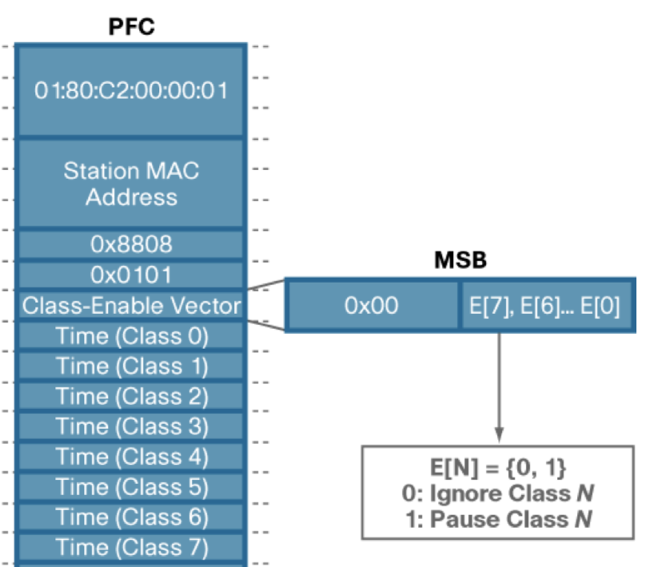
PFC Format
priority_enable_vector
Time : duration of pause time
= 2 Byte value * time needed to
transmit 512 bits link

Slide 23

Lossless Flow Control
InfiniBand: Credit Based Flow Control (CBFC)
Credits
23
“Gentle Flow Control” in Sigcomm 2019
Notes:
In InfiniBand, Credit Based Flow Control is proposed.
The downstream port periodically [click] send back credits [click] , and the upstream port control the sending status accordingly.
Although these flow control mechanisms can efficiently eliminate packet loss.
They introduce a strong relationship between the buffer in the upstream and downstream nodes.
An concomitant problem occurs, which is called network deadlock.

Slide 24
PFC (Priority Flow Control)
PFC limitation:
PFC can lead to poor application performance due to :
Head-of-line blocking
Unfairness
Congestion spreading → Victim flow
Deadlock

Slide 25
PFC (Priority Flow Control)
Head-of-line blocking:
Large flow
Port 1
PAUSE
P₂
P₁
Small flow
PFC operates at the port level, and it cannot distinguish flows. When congestion occurs, it will cause head-of-line blocking.
Packet 1 of a flow destines for a congested port of a downstream switch and gets paused. Packet 2 of another flow destines for another uncongested of the switch port but gets blocked.

Slide 26
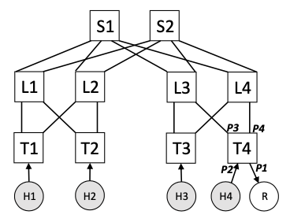
Unfairness in PFC
Assuming H1-H4 send flows to R
When queue starts building up on T4, it pauses incoming links (ports P2 - P4).
However, P2 carries just one flow (from H4), while P3 and P4 may carry multiple flows since H1, H2 and H3 must share these two ports, depending on how ECMP maps the flows.
Thus, H4 receives higher throughput than H1-H3. This is known as the parking lot problem

Slide 27
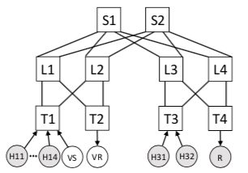
Victim Flow in PFC
Consider a case where 4 senders (H11-H14) send data to R and a “victim flow” – VS sends data to VR, and each link capacity 40 Gb/s.
H11-H14 share the bottleneck bandwidth to R, and each gets 10 Gb/s. VS-VR is supposed to get 20 Gb/s. But because the output buffer at the link triggers PFC pause frames spreading to all the senders of T1, it only gets 10 Gb/s*.
If senders H31 and H32 also send to R, the throughput of VS-VR drops further to 4.5 Gb/s*, even though no path from H31 and H32 to R has any links in common with the path between VS and VR.
This happens because H31 and H32 compete with H11-H14 on L3 and L4, make them PAUSE S1 and S2 longer, and eventually make T1 PAUSE senders longer.
* DCQCN, Sigcomm 2015

Slide 28
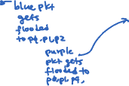
PFC deadlock
La
Lb
Path: {S1, T0, La, T1, S3}
p0
p1
p0
p1
Path: {S1, T0, La, T1, S5}
Path: {S4, T1, Lb, T0, S2}
PFC pause frames
2
3
1
4
Congested port
Ingress
port
p2
p3
p3
p4
T1
Egress
port
T0
p0
p1
p0
p1
p2
Dead server
PFC pause frames
Packet drop
If MAC entry is missing, packets are flooded to all ports.
Server
S1
S2
S3
S4
S5

Slide 29
Deadlock in Lossless Network
“Gentle Flow Control” in Sigcomm 2019
Cyclic Buffer Dependency (CBD)
29
Notes:
This figure illustrates a simple example of deadlock.
Network deadlock refers to a standstill situation:
[click] a Cyclic Buffer Dependency (CBD) exists in the network,
[click] while all switches in this cycle pause the upstream port
and wait for the downstream port to resume packet transmission at the same time.

Slide 30
Deadlock in Lossless Network
“Gentle Flow Control” in Sigcomm 2019
30
Notes:
Furthermore, these ports will pressure congestion back to sources and then cease all ports along the path.
[click] Finally, the whole (or part of) network would be disabled.
Deadlock is a silent killer. Once it occurs, the network cannot resume to normal state autonomously.
The example we use here is simple and fictive, we will give a practical network deadlock case study in the evaluation part.

Slide 31
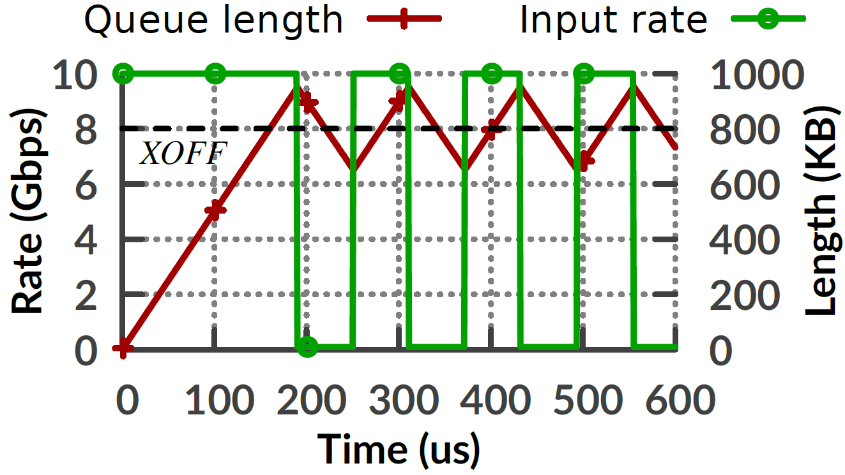
“Hold and Wait” in PFC
With a 10Gbps network, 2 flows share link with XOFF = 800 KB, XON=770KB.
The ingress queue length fluctuates near XON and XOFF.
The sending rate alternates between zero and line rate.
Hold and wait
If hosts control the sending rate at 5Gbps,
“hold and wait” can be avoided!
31
“Gentle Flow Control” in Sigcomm 2019
Notes:
We first use a simple 2-to-1 case to understand why hold and wait occurs.
The link capacity is 10Gbps so the draining rate of each ingress queue is 5Gbps.
We deploy PFC as an representation. The results shows the evolutions of ingress queue length and sending rate.
The ingress queue length fluctuates near XON and XOFF.
The sending rate alternates between zero and line rate accordingly.
Obviously, the upstream port goes into the cease status frequently.
[click] Thus, packets in the upstream egress queue experience the hold and wait situation.
[click] Actually, If hosts can keep the sending rate at 5Gbps, every flow can continuously pass through the network.
The queue length in each port is steady and no hold and wait occurs.

Slide 32
HPCC
HPCC: High Precision Congestion Control
Sigcomm 2019

Slide 33
Congestion Control in DC
CC is the key to achieve:
Ultra-low latency
High bandwidth
Network stability
Existing high-speed CC schemes have inherent limitations for reaching these goal simultaneously. Existing schemes used to facilitate CC include:
Drop tail and drop front
ECN bit marking
RED (random early detection) – two thresholds to guide marking prob
CoDel – setting limits on the delay of packets to improve over RED
HPCC, a new high-speed CC scheme leverage INT (In-band Network Telemetry) information to obtain precise link load information and control traffic precisely.

Slide 34
Inherent limitation of current RDMA CC
Traditional CC in modern datacenter base on RDMA:
DQCQN (Sigcomm 2015): widely used in today’s DC
Timely (Sigcomm 2015)
Limitation of traditional CC:
Slow convergence
Unavoidable packet queueing
Complicated parameter tuning

Slide 35
Inherent limitation of current RDMA CC
Slow Convergence:
With feedback signal, such as ECN or RTT, CC schemes don’t know the exact how much to increase or decrease sending rates. They “guess” and try to iteratively converge to a stable rate. Such iterative methods are very slow.
Unavoidable packet queueing:
Senders starts to reduce flow rate only after a queue builds up, Problematic case 2.
Complicated parameter tuning:
Lack of fine-grained network information increases the risk of incorrect setting. For instance, DCQCN has 15 knobs to set up. As a result, operators usually face a complex and time-consuming parameter tuning stage in daily RDMA net- work operations.

Slide 36
Inherent limitation of current RDMA CC
The key idea that HPCC can solve the above problem is to leverage the precise link load information provided by INT.
X Slow Convergence: No more guessing, use precise link load information to calculate the sending rate.
X Unavoidable packet queueing: Senders quickly adjust the flow rate to keep each link’s input rate slightly lower than the link capacity.
X Complicated parameter tuning sending rates are computed by direct measurement, and HPCC only have three parameters to tune fairness and efficiency.

Slide 37
Properties of next generation of high-speed CC
Next generation high-speed CC for RDMA should have follow properties:
Fast Converge
Close-to-empty queue
Few parameters to tune
Fairness
Easy to deploy on hardware

Slide 38
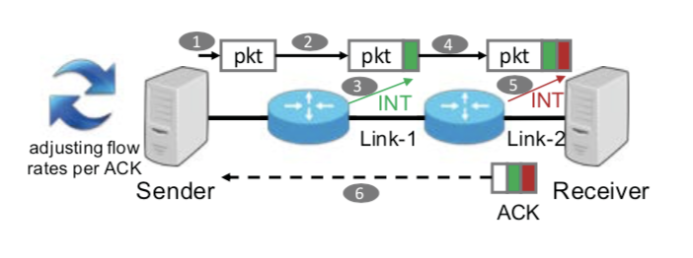
INT information of each link of a switch
INT carries the following 4 pieces of info set by each switch
Link capacity | Time stamp | txBytes | qlen
10 Gbps | 10 micro-sec | 111M bits | 5M bits
10 Gbps | 12 micro-sec | 130M bits | 19M bits
ACK t
Ack t+1
txBytes: the total number of bytes sent to an output link until now
qlen: the current queue length

Slide 39




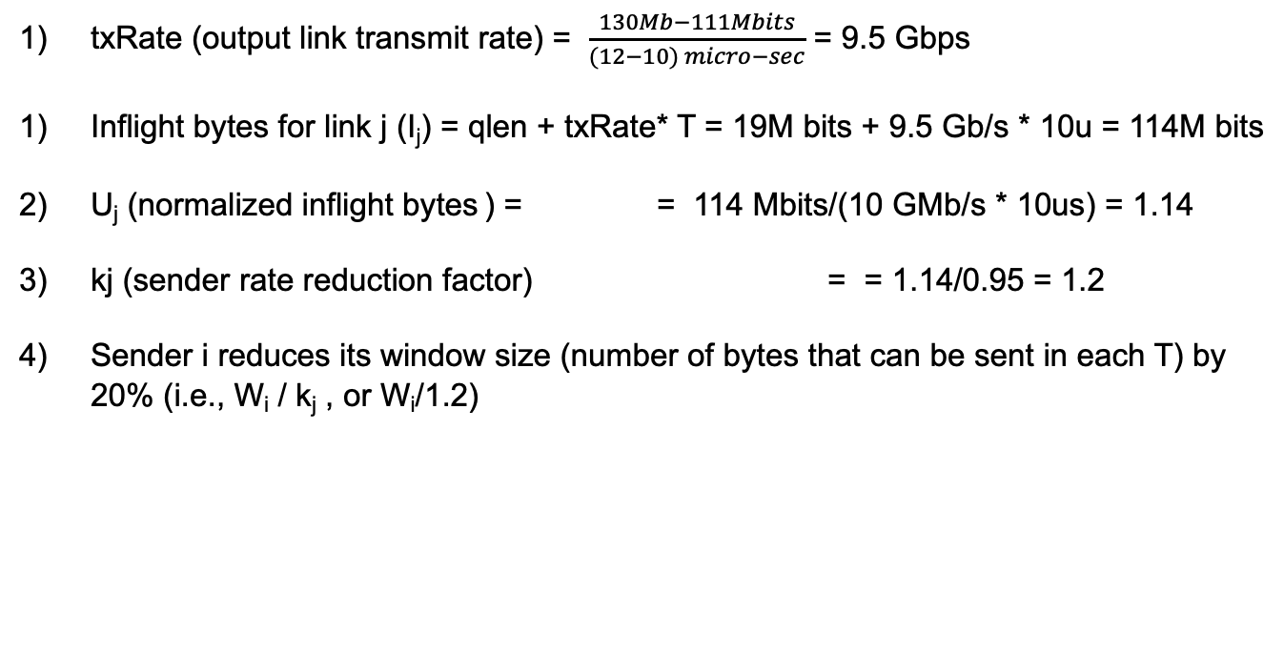
Sender performs the following calculations on ACK (t+1)
Assume minRTT = 10 usec, denoted as T
𝜂 = target link utilization = 95%
Buffer
qlen:19M bits
txRate= 9.5 Gbps
Link j
Link Capacity: 10 Gbps
txRate (output link transmit rate) = $\frac{130Mb−111Mbits}{(12−10) micro−sec}$ = 9.5 Gbps
Inflight bytes for link j (I_{j}) = qlen + txRate* T = 19M bits + 9.5 Gb/s * 10u = 114M bits
U_{j} (normalized inflight bytes ) = = 114 Mbits/(10 GMb/s * 10us) = 1.14
kj (sender rate reduction factor) = = 1.14/0.95 = 1.2
Sender i reduces its window size (number of bytes that can be sent in each T) by 20% (i.e., W_{i} / k_{j} , or W_{i}/1.2)

Slide 40




Design of HPCC
Procedure of estimating inflight bytes using INT information
Calculate txRate,
I_{j} : inflight bytes , qlen: queue length, txRate: transmit rate, T=minRTT
Each sender adjusts its window so that I_{j} for each link j is slightly lower than B_{j}*T ( ), where B_{j} is the link capacity of link j.
Each sender can reduce its window by a factor
U_{j} is the normalized inflight bytes

Slide 41
Challenges to design HPCC
1st challenge to design HPCC
Delay of INT information:
INT information piggybacked on packets can be delayed by congestion, which can defer the flow rate reduction for resolving the congestion.
Solution:
HPCC algorithm limits and controls the total inflight bytes on a bottleneck link, preventing senders from sending extra traffic even if the feedback gets delayed.

Slide 42
Challenges to design HPCC
2nd challenges to design HPCC
Overreaction:
INT information is carried in every ACK packet. Reacting to each ACK enables fast congestion avoidance, but it reacts multiple times to ACKs describing the same packets and queues and it will overreact to the network link states.
Solution:
HPCC algorithm selective uses INT information by combining per-ACK and per-RTT reaction.

Slide 43
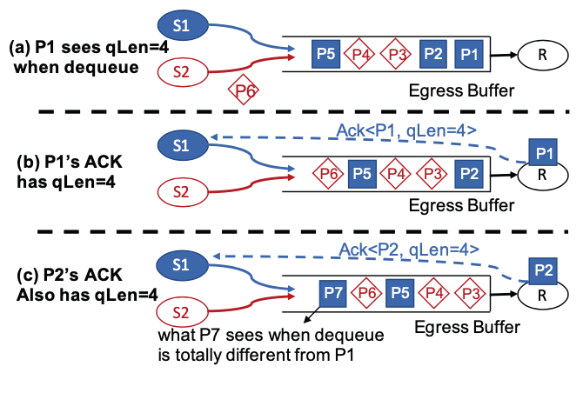
Overreact by making multiple CC on same state
P1 and P2’s ACKs report the link conditions for almost the same set of packets.
For instance, P7 is a packet which is sent out from S1 after S1 gets the ACK of P1. Therefore, the packets P7 sees in any queue are totally different from what P1 sees.
For avoiding overreaction, we always remember the first packet (Q) sent right after the window is adjusted and only adjust the window again when the sender gets Q’s ACK.
The drawback of this strategy is that merely, updating window each RTT might be too slow for handling urgent cases like failures and incasts.

Slide 44

Challenges to design HPCC
HPCC combine the per-ACK and per-RTT strategies to achieve fast reaction without overreaction
Introduce a reference window size W_{i}^{c}, a runtime state updated in per-RTT basis. W_{AI} is an additive increase, which is very small, to make it as AIMD, ensuring fairness,
Only when receiving the ACK of first packet sent after updating W_{i}^{c} (e.g., P7), W_{i}^{c} will be updated, ensuring W_{i}^{c} is updated per RTT.
While W_{i}^{c} is only updated per RTT, W_{i} is still updated per ACK according to U_{j} and will be reflecting the changes of queue lengths and link transmission rates.

Slide 45
Evaluation
Traffic loads: WebSearch, FB_Hadoop.
Test strategies: HPCC, DCQCN and Timely
Performance metrics:
(i) FCT slow down
(ii) Real-time bandwidth of individual flows
(iii) Network latency
(iv) PFC pause duration
(v) Size of in-network queues

Slide 46
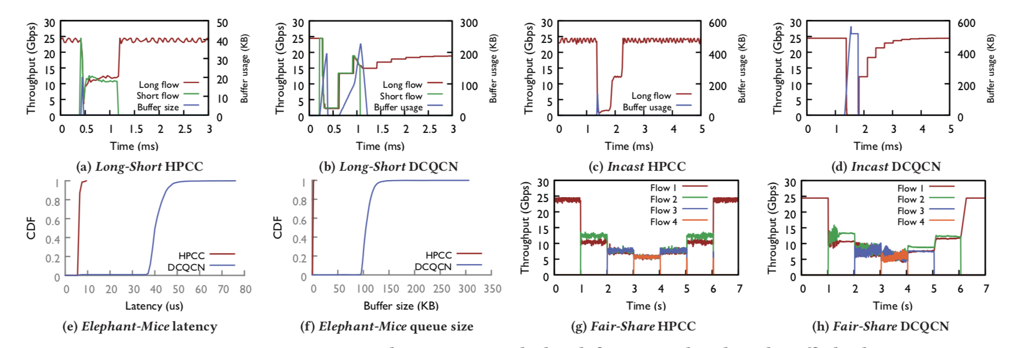
Evaluation
Fast recovery
Faster congestion avoidance
Lower network latency
Fairness

Slide 47
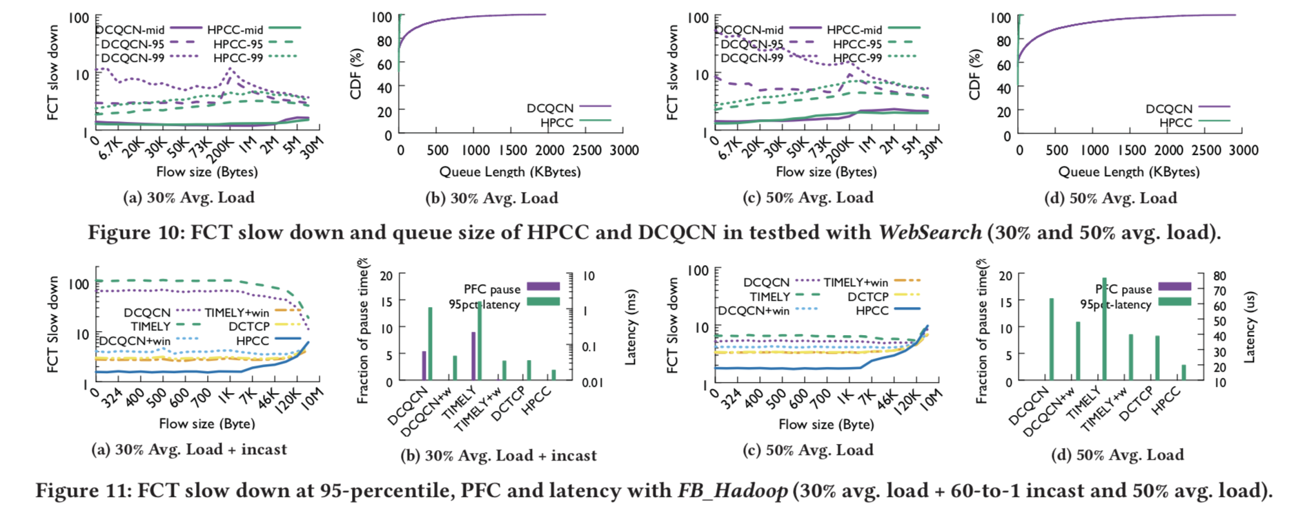
Evaluation

Slide 48
Conclusion
Traditional high speed congestion control schemes have inherent limitation.
HPCC, a next generation CC for high speed network, achieves ultra-low latency, high-bandwidth and stability simultaneously.
HPCC achieves fast convergence, small queue, and fairness by leveraging precise load information from INT.

